Slide 1


Slide 2
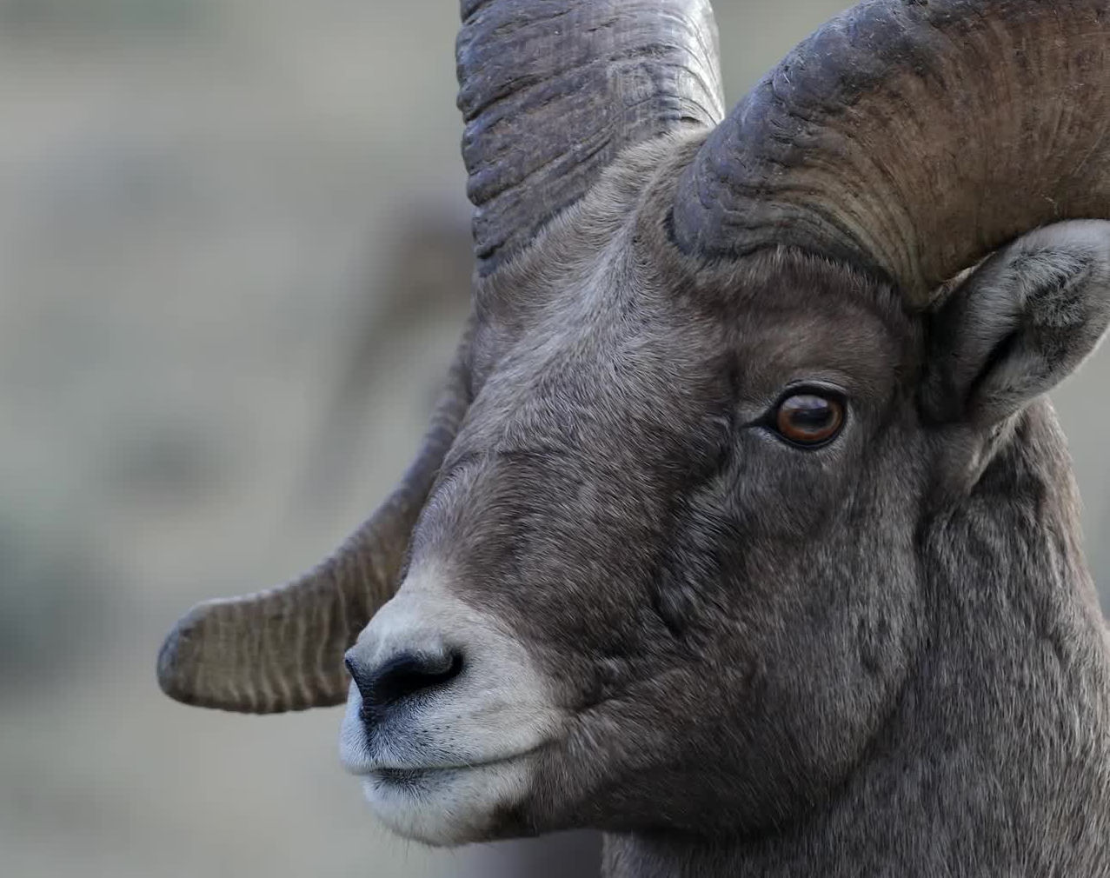
THE GOAT DEBATE

Slide 3
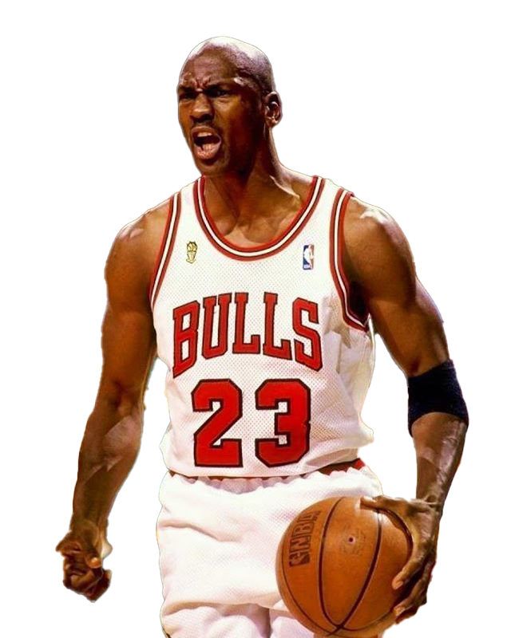

Michael Jordon

Slide 4
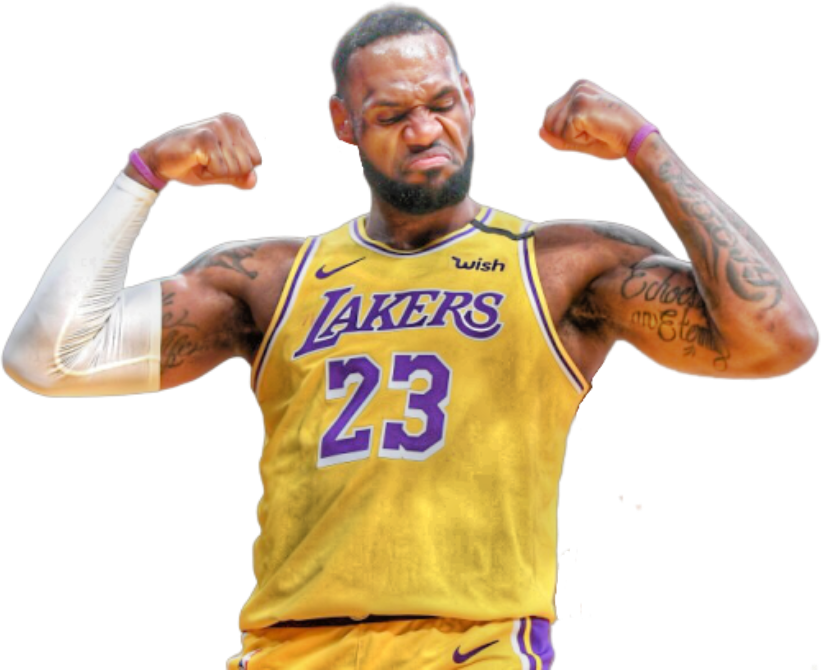
Lebron James

Slide 5
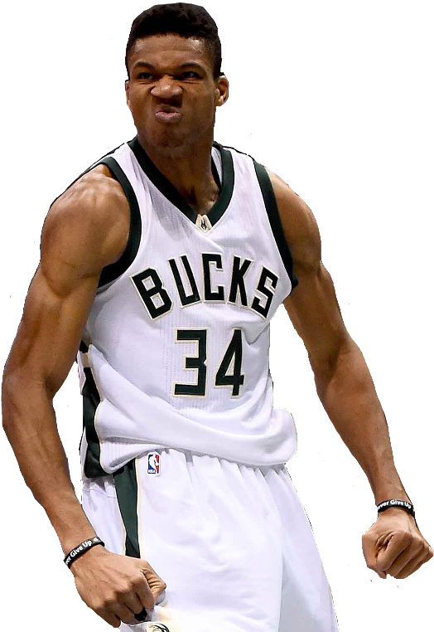
Giannis Antetokounmpo

Slide 6

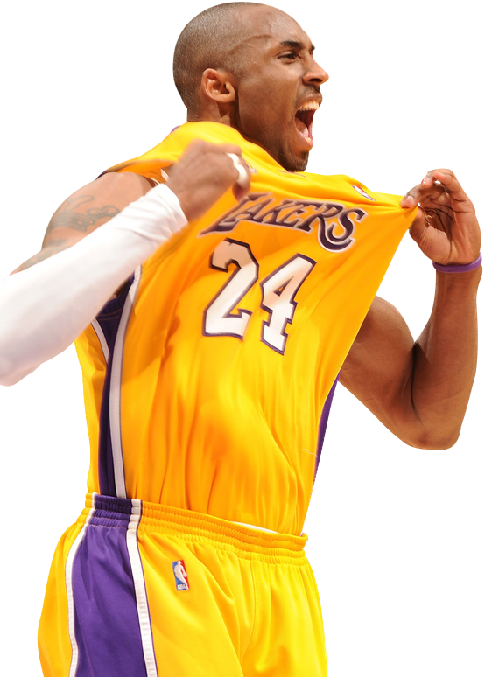
Kobe

Slide 7
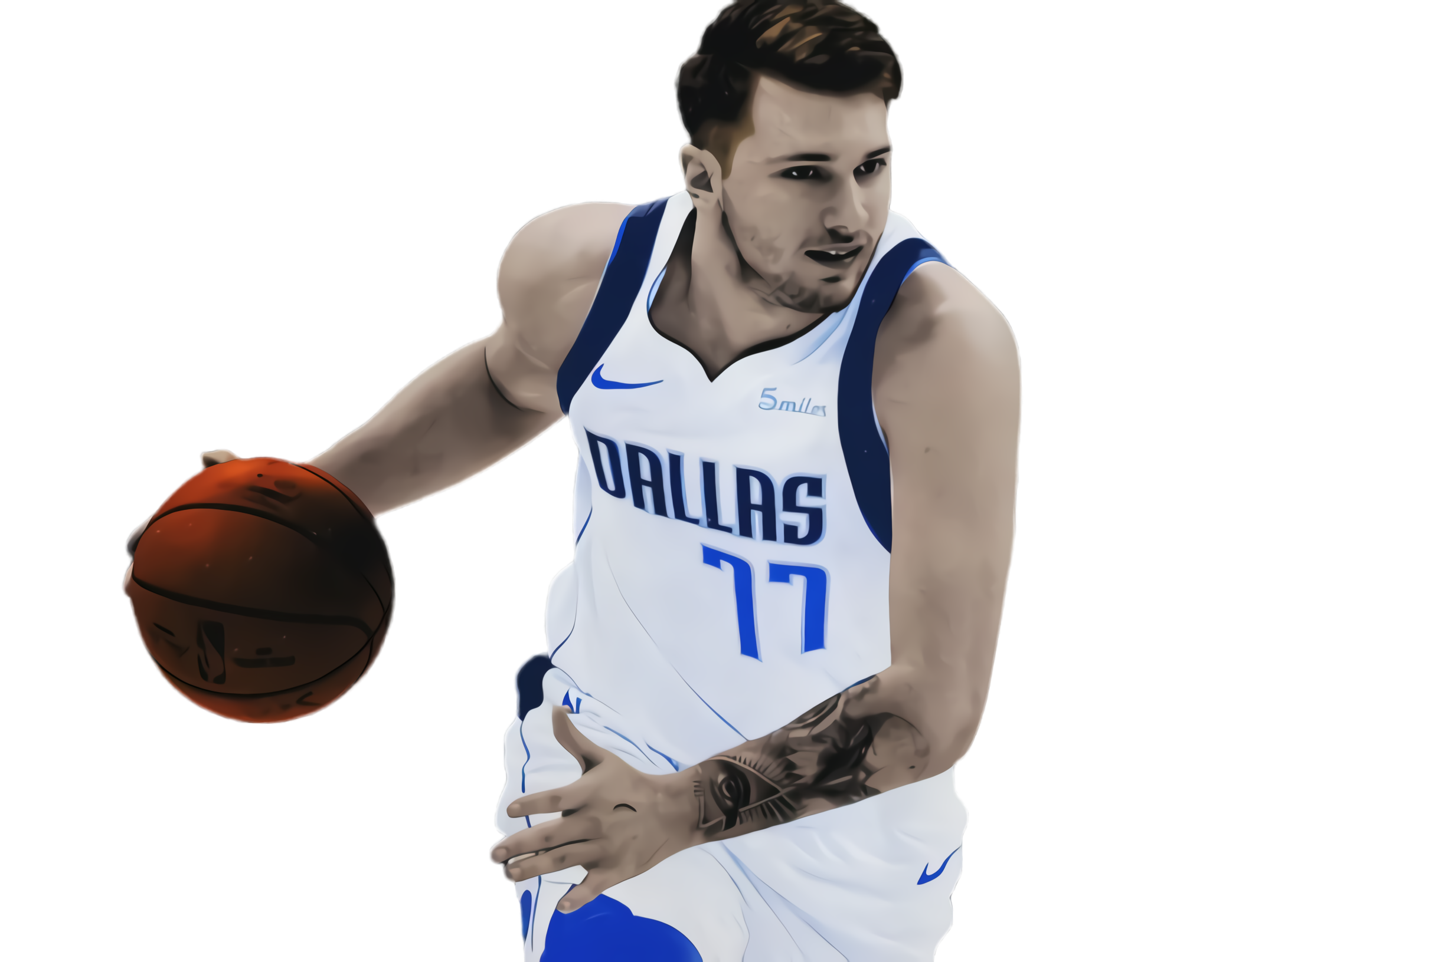
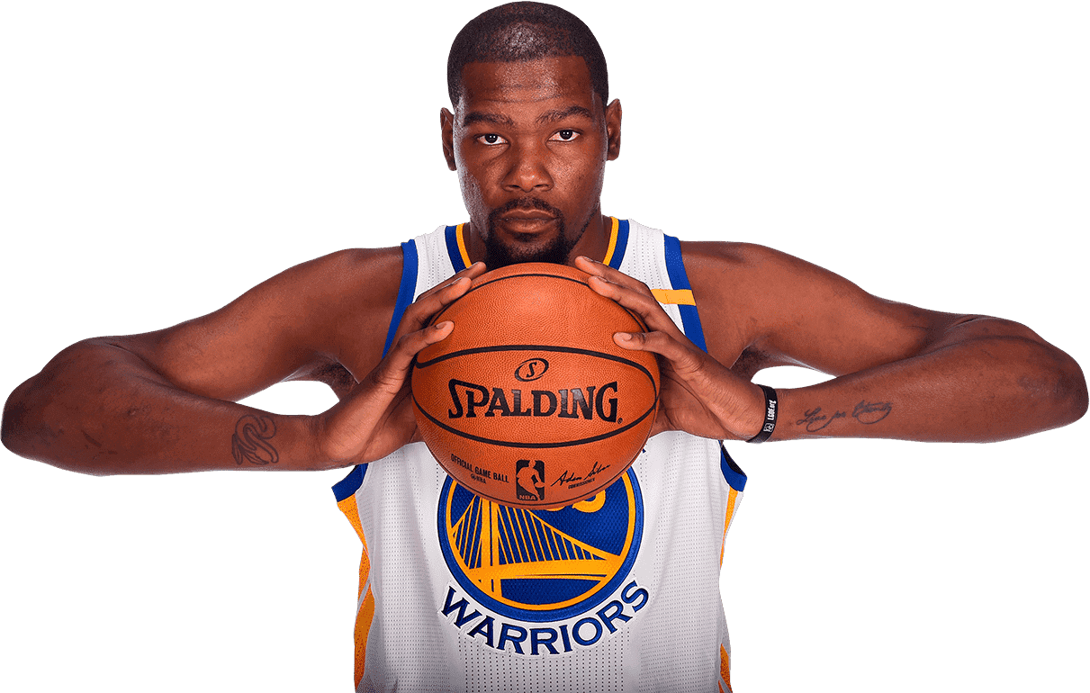

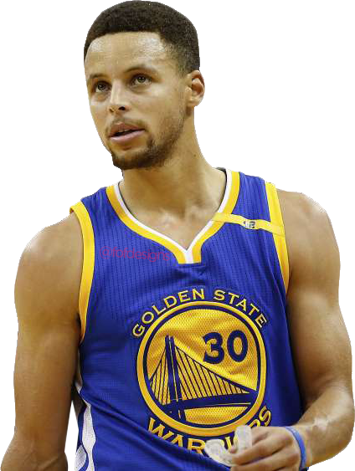

Slide 8
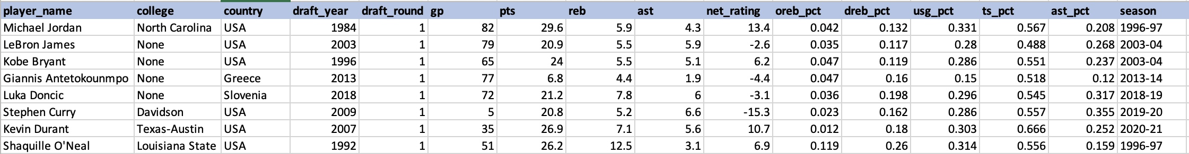
What does the data Say ?

Slide 9

Who Will Win it All ?

Slide 10
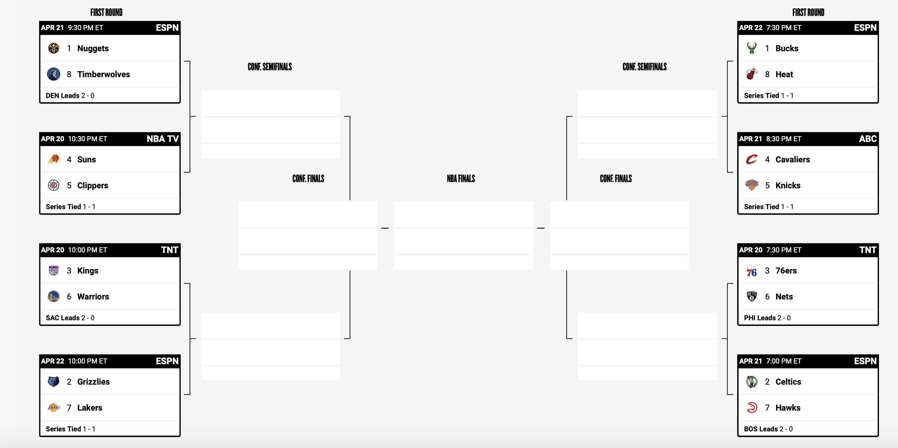

Slide 11
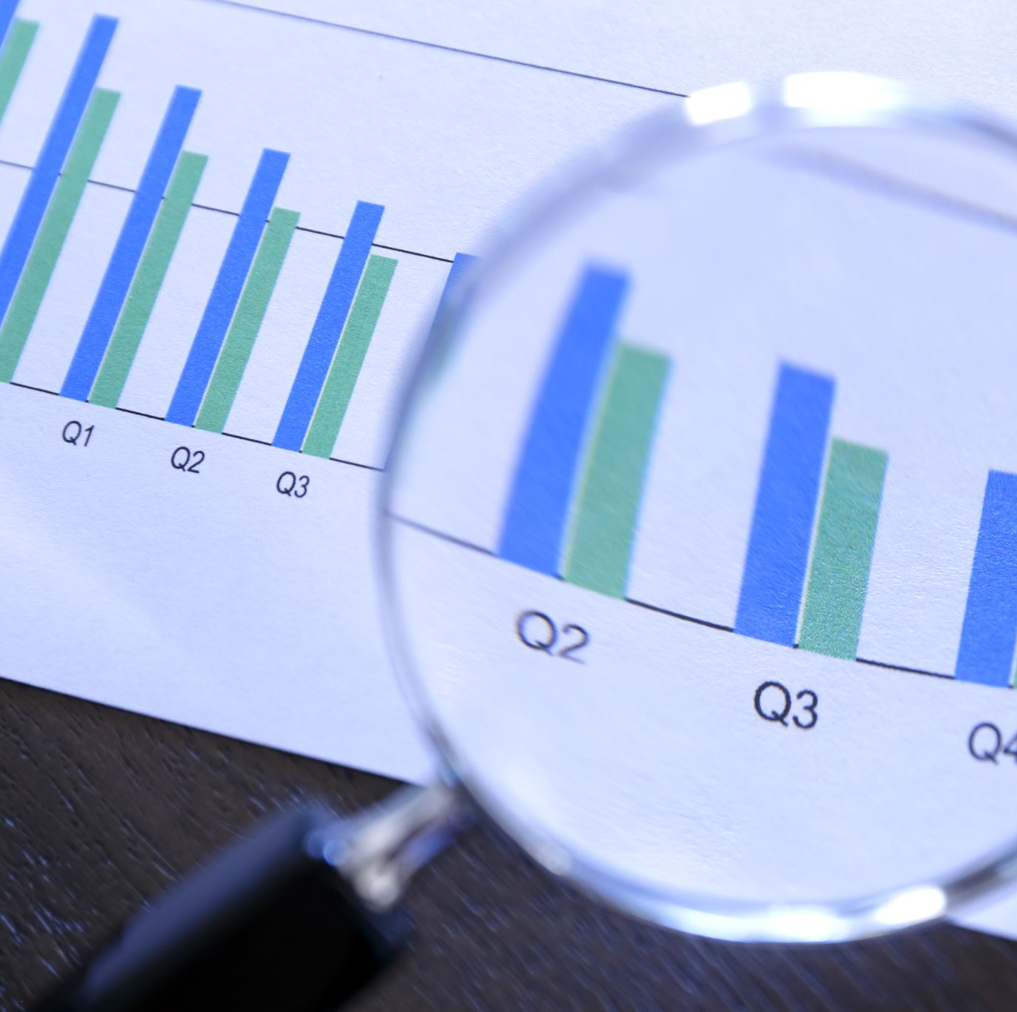
Visualizations - RoadMap
Goat Debate ?: We intend to use Histograms , Scatter plots and Time Series visualization and others, if possible, to solve the goat debate.
Who Will Win it All ? : We intend to use geo visualizations to plot teams based on their home grounds in an interactive way and radar charts or radial charts to compare the strengths of each teams

Slide 12
Datasets
https://www.kaggle.com/datasets/justinas/nba-players-data
https://www.basketball-reference.com/leagues/NBA_2023.html

Slide 13
Who will do what? – Group 6
Each member of the team will take different tasks, as we are using multiple visualizations, we decided to take up individual visualizations. We intend to use a project Git repository, where all our code will be merged to gain collective inference or insights.
Objective – To Provide clear or meaningful insights with the help of appealing and interactive information visualizations

